Slide 1

Tea Top
Elise, Julie, Xiomara

Slide 2
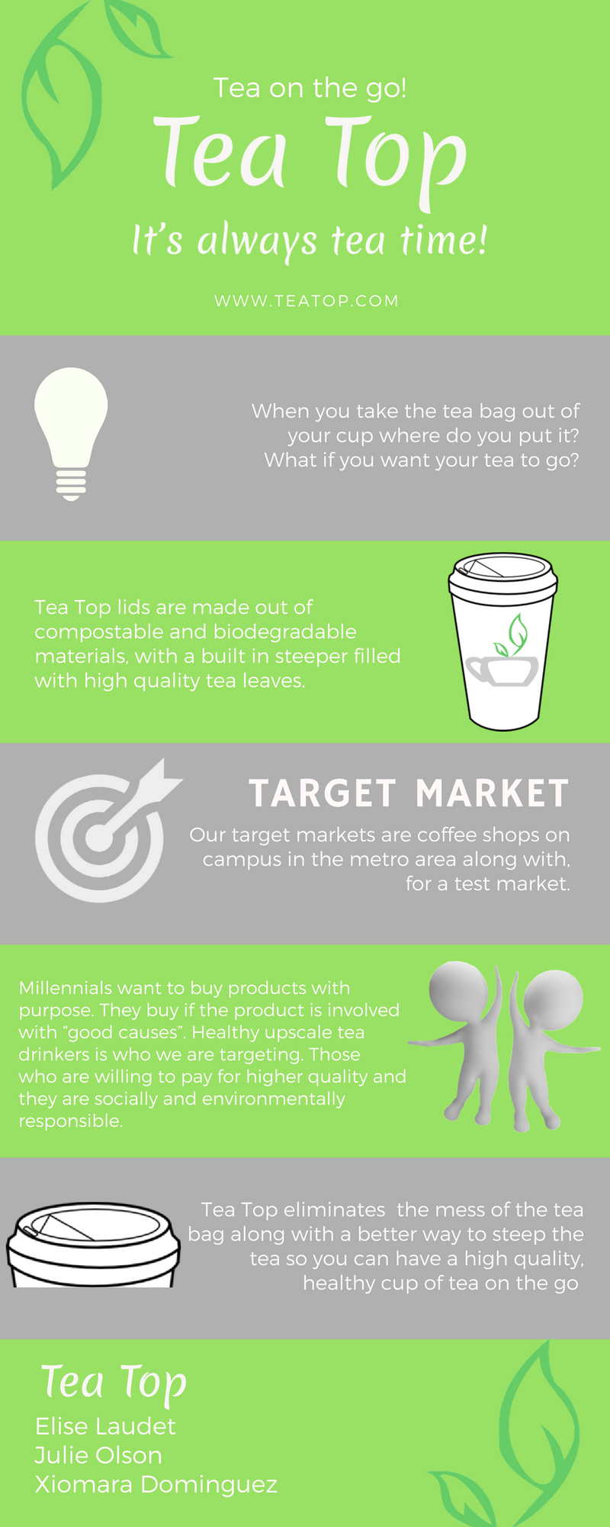
Problem
Notes:
When a person wants a cup of tea there are a couple of choices instant or tea bags. Instant tea tastes ok but it looses all health benefits in the process of making it instant. Tea bags are great and can have the health benefits but to steep tea, it can be a mess, and where do you put the tea bag? If you leave it in the cup it makes the tea bitter and over steeped. When you take the tea bag out of your cup where do you put it? What if you want it to go? What do you do with the tea bag then?

Slide 3
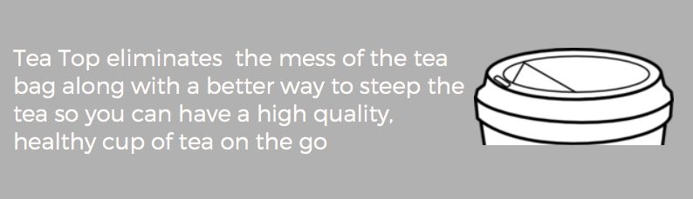
Problem Solved

Slide 4
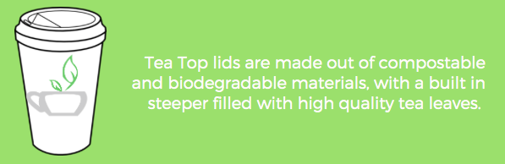
Benefits
Notes:
Tea Top solves this issue. Tea Top lids will be an universal/standard size that fit the cups already used in the cafeterias and coffee shops. This lid is made out of, a compostable and biodegradable material, with a built in steeper filled with high quality tea leaves. The lid is designed to eliminate the inconvenience of the traditional tea bag.

Slide 5
Target Market
Notes:
Our target markets are coffee shops on campus in the metro area along with co-op markets, for a test market. According to the world tea directory, the US demand for tea has increased in recent years, most likely due to increased -national interest in health and diet. With that in mind, we want to appeal to a healthy beverage customer. From our research we have concluded that healthy upscale tea drinkers are willing to pay for higher quality, they are socially and environmentally responsible. Also, consistency is essential for customer perception. What our customers look for is functionality in packaging.

Slide 6
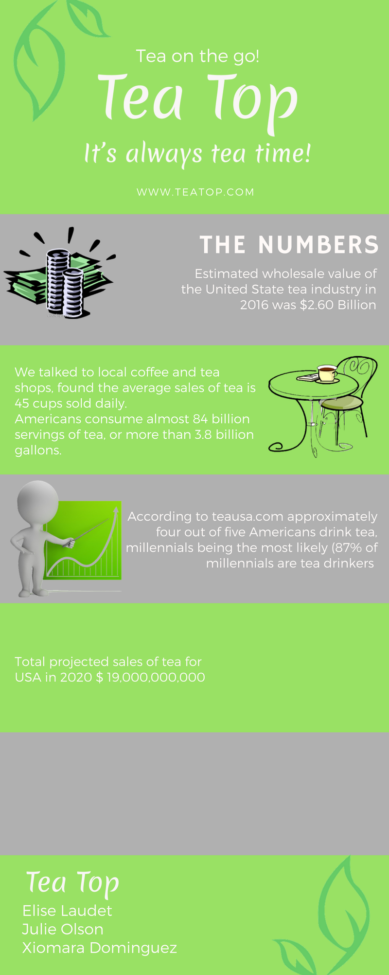
Growth

Slide 7
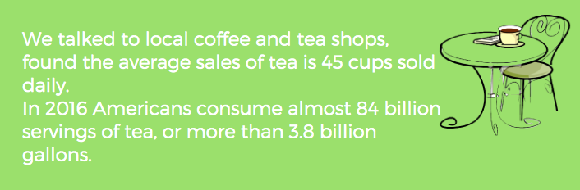
Marketplace

Slide 8
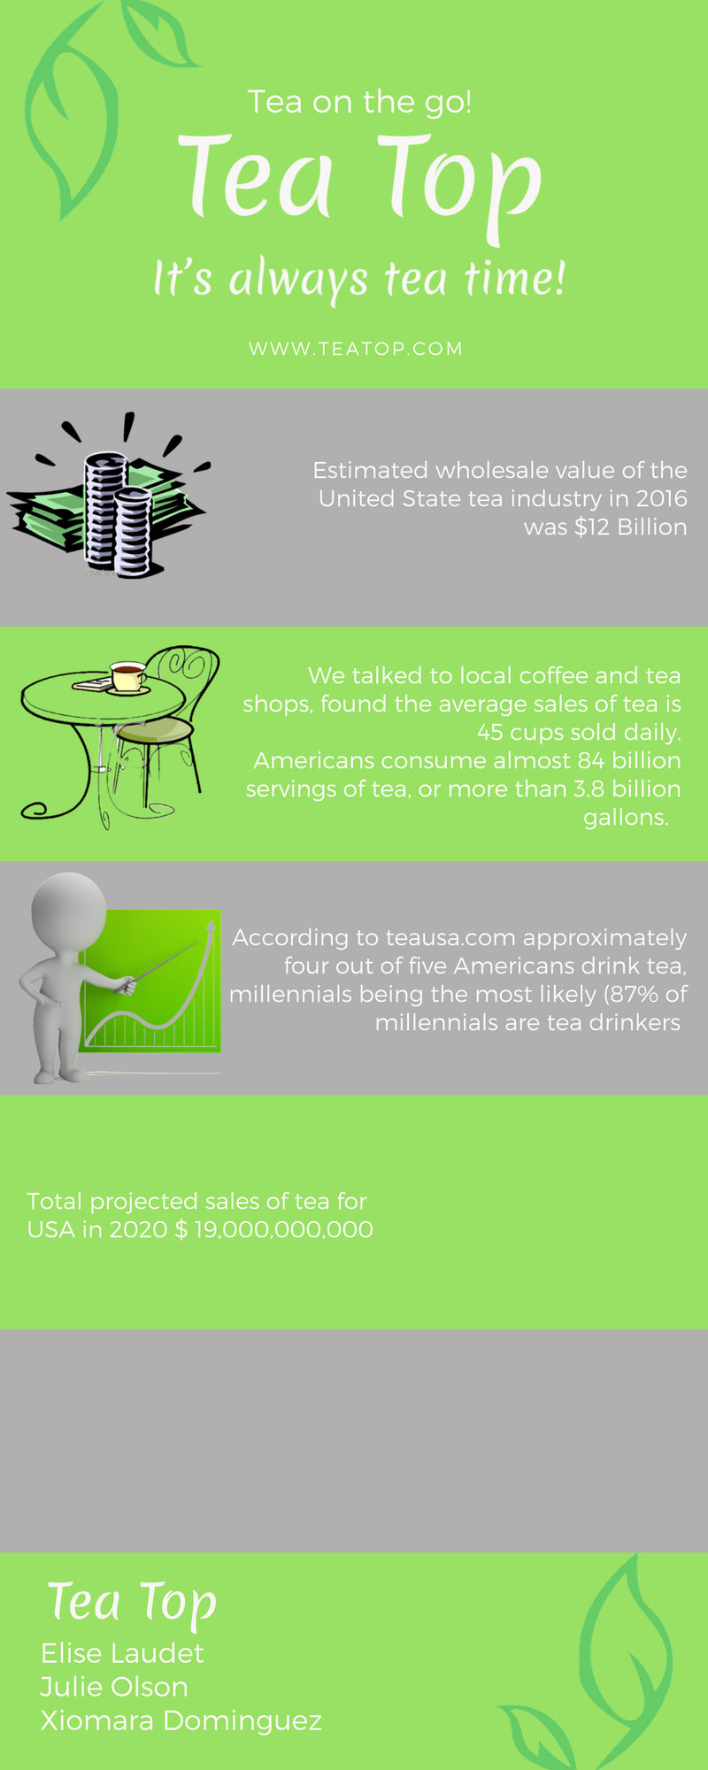
Tea Industry Potential
Notes:
Our target markets are coffee shops on campus in the metro area along with co-op markets, for a test market. According to the world tea directory, the US demand for tea has increased in recent years, most likely due to increased -national interest in health and diet. With that in mind, we want to appeal to a healthy beverage customer. From our research we have concluded that healthy upscale tea drinkers are willing to pay for higher quality, they are socially and environmentally responsible. Also, consistency is essential for customer perception. What our customers look for is functionality in packaging.

Slide 9
Tea Top
It’s always tea time.
Elise, Julie, Xiomara

